Slide 1
The Female Reproductive System
Interactive Tool
INSTRUCTIONS
Place your mouse over the major organs of the female reproductive system to discover their role in the female reproductive system.

Slide 2
The Female Reproductive System
OVARY
FALLOPIAN TUBE
UTERUS
CERVIX
VAGINA

Slide 3
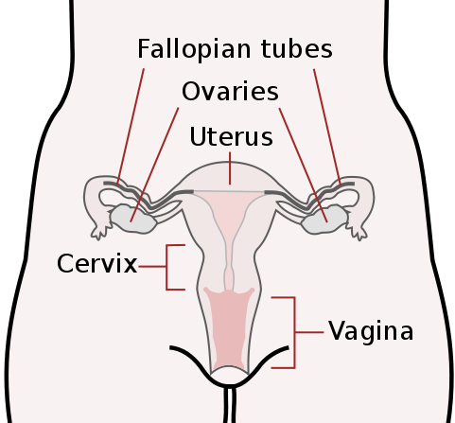
THE VAGINA
The vagina is a muscular, hollow tube that extends from the vaginal opening to the uterus. The vagina is about 8 to 12 centimeters long in a grown woman.
Because it has muscular walls, it can expand and contract. This ability to become wider or narrower allows the vagina to accommodate something as slim as a tampon and as wide as a baby.
The vagina's muscular walls are lined with acidic mucous membranes, which keep it protected.
The vagina serves three purposes:
It's where the penis is inserted during sexual intercourse
It's the pathway that a baby takes out of a woman's body during childbirth, called the birth canal.
It provides the route for the menstrual blood (the period) to leave the body from the uterus
Interesting Fact:
According to The Guinness Book of World Records, a Russian peasant woman who lived in the 18th Century holds the record for the most children born to one mother. She had sixty-nine children within forty years. She produced sixteen pairs of twins, seven sets of triplets, and four sets of quadruplets!
YOU ARE HERE

Slide 4
THE CERVIX
The vagina connects with the uterus, or womb, at the cervix.
The cervix has strong, thick walls.
The opening of the cervix is very small (no wider than a straw).
During childbirth, the cervix can expand to allow a baby to pass.
YOU ARE HERE

Slide 5
THE UTERUS
The uterus or "womb" is a hollow, muscular organ in which a fertilized egg, called the "zygote," becomes embedded and in which the egg is nourished and allowed to develop until birth.
It lies in the pelvic cavity behind the bladder and in front of the bowel.
The uterus is lined with tissues which change during the menstrual cycle.
The major tissues of the Uterus include the Endometrium and the Myometrium.
Endometrium:
lining of the uterine cavity . In all placental mammals, including humans, the endometrium builds a lining periodically which is shed if no pregnancy occurs.
Myometrium:
The uterus mostly consists of smooth muscle, known as Myometrium.
This muscle has the ability to contract and exert large amounts of
force during child birth.
YOU ARE HERE

Slide 6
THE FALLOPIAN TUBES
The fallopian tubes connect the uterus to the ovaries.
There are two fallopian tubes, each attached to a side of the uterus.
The fallopian tubes are about 10 centimeters long and about as wide as a piece of spaghetti. Within each tube is a tiny passageway no wider than a sewing needle.
At the other end of each fallopian tube is a fringed area with protrusions called ‘fimbrae’ that look like fingers.
This fringed area wraps around the ovary but doesn't completely attach to it. When an egg pops out of an ovary, it enters the fallopian tube via the aid of the fimbrae.
Once the egg is in the fallopian tube, tiny hairs in the tube's lining help push it down the narrow passageway toward the uterus
The lining of the tube and its secretions sustain both the egg and the sperm, encouraging fertilization and nourishing the egg until it reaches the uterus.
YOU ARE HERE

Slide 7
THE OVARIES
The ovaries are a pair of oval or almond-shaped glands which lie on either side of the uterus and just below the opening to the fallopian tubes.
In addition to producing eggs or "ova," the ovaries produce female sex hormones called oestrogen and progesterone.
YOU ARE HERE
Interesting Fact:
The female, unlike the male, does not manufacture the sex cells. A girl baby is born with about 60,000 of these cells, which are contained in sac-like depressions in the ovaries. Each of these cells may have the potential to mature for fertilization, but in actuality, only about 400 ripen during the woman's lifetime.

